Slide 1

Personalized medication and lifestyle companion

Slide 2
NAME : Shristy Chaudhary
SEC : AI & ML
UNIVERSITY ROLL : 2019498
CLASS ROLL : 29

Slide 3
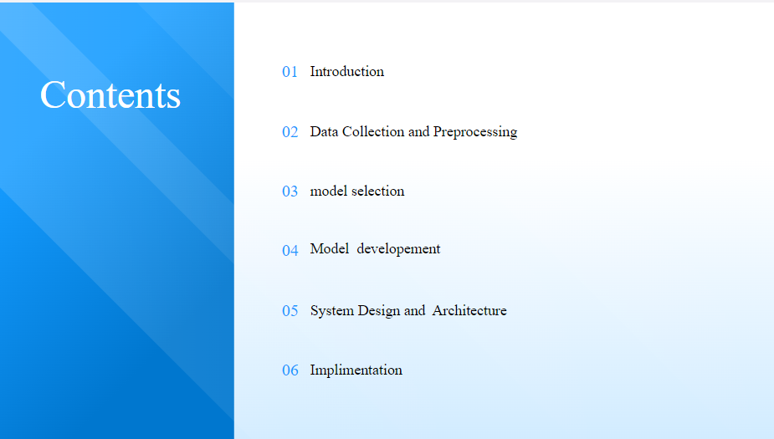

Slide 4
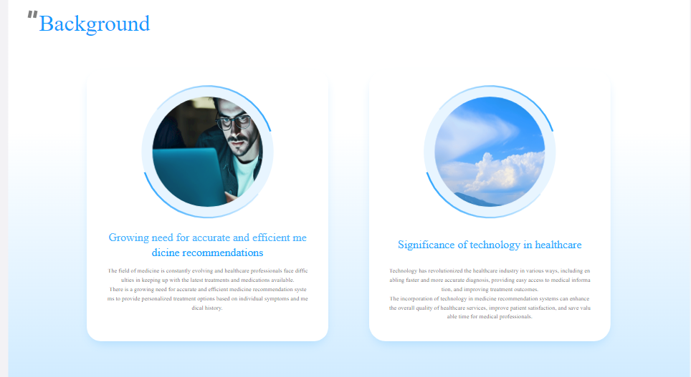

Slide 5
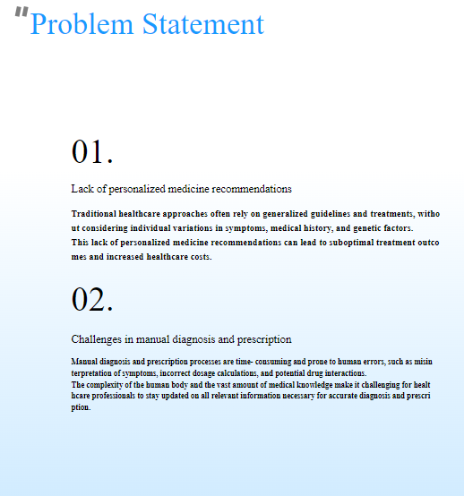
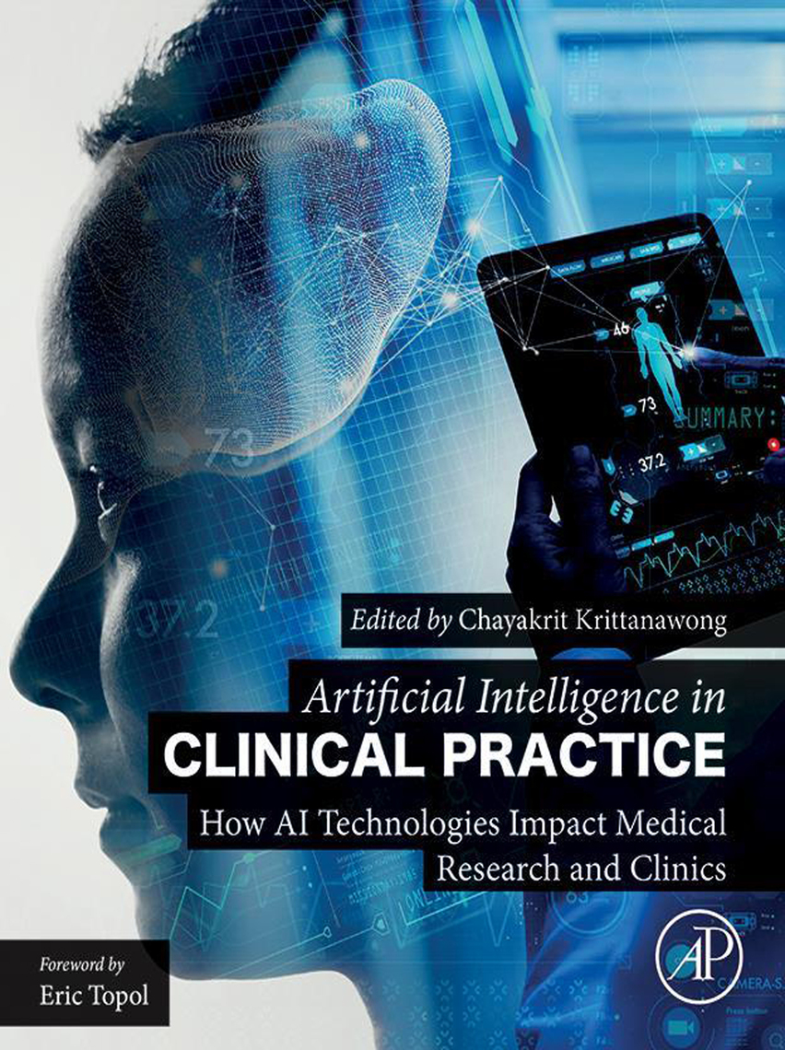

Slide 6
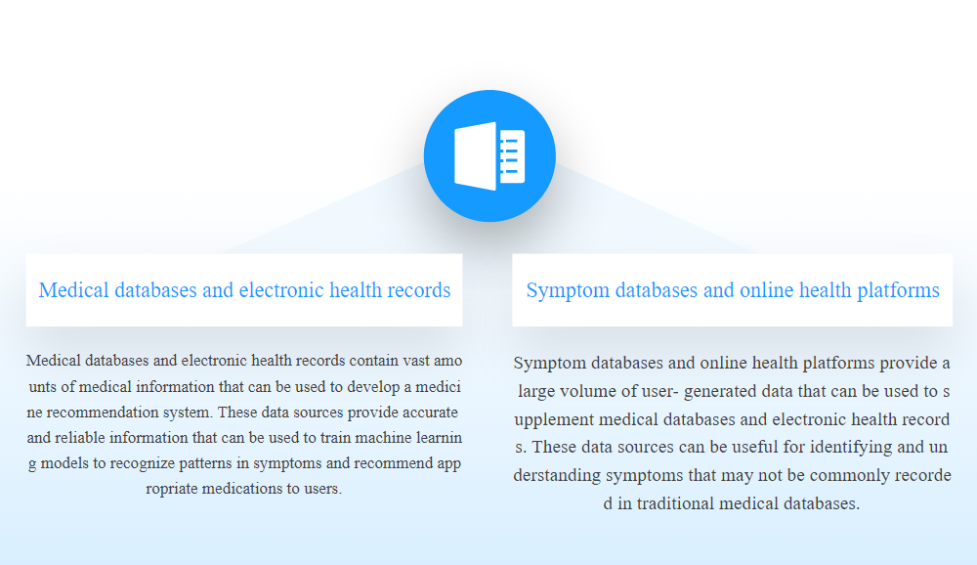

Slide 7
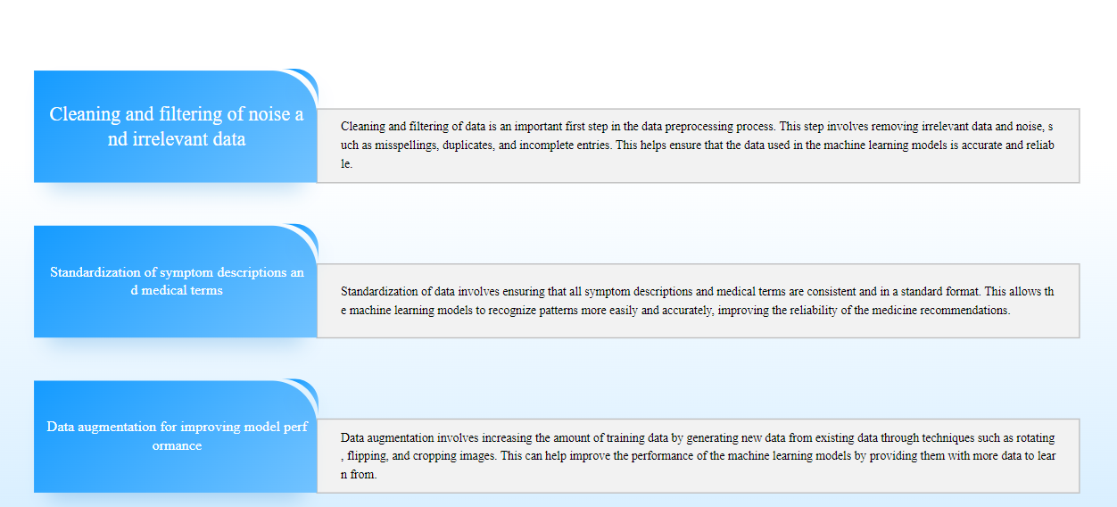

Slide 8
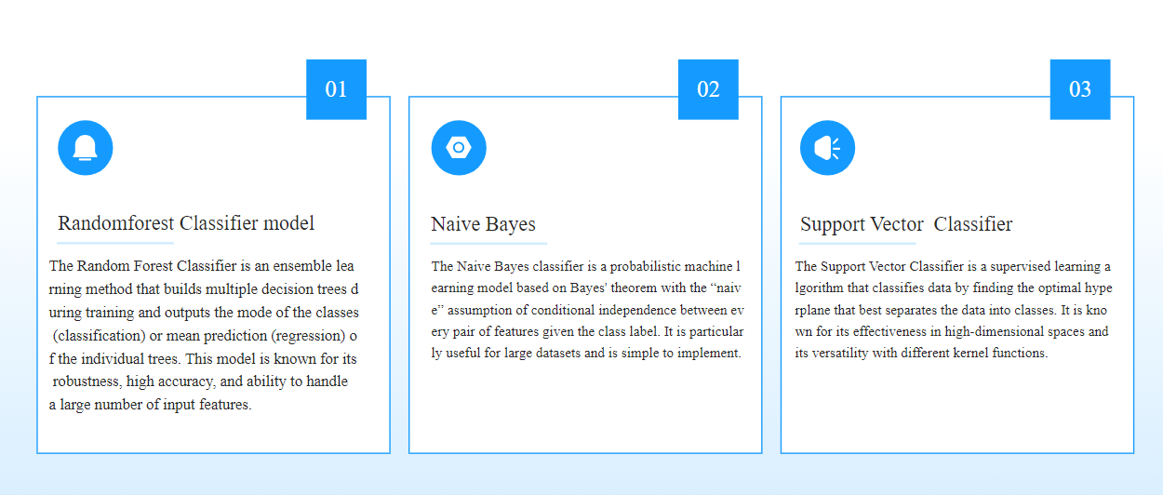

Slide 9
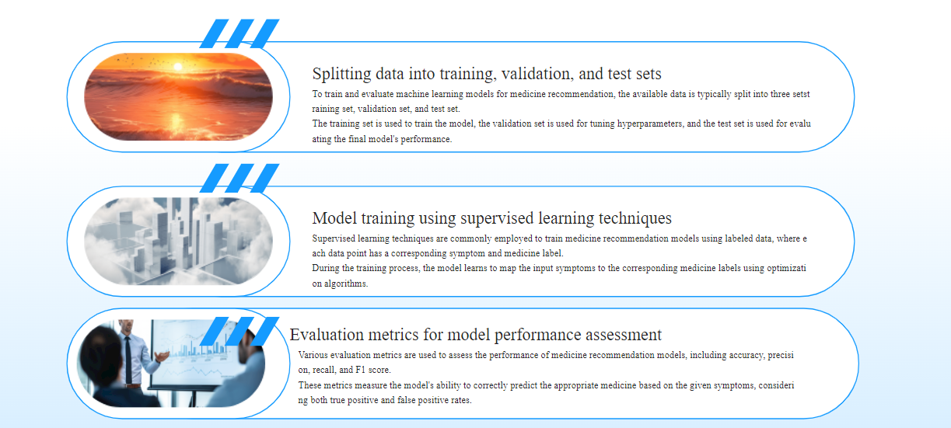

Slide 10
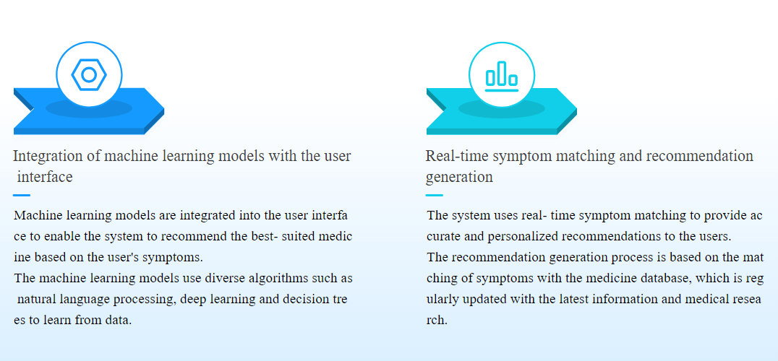

Slide 11
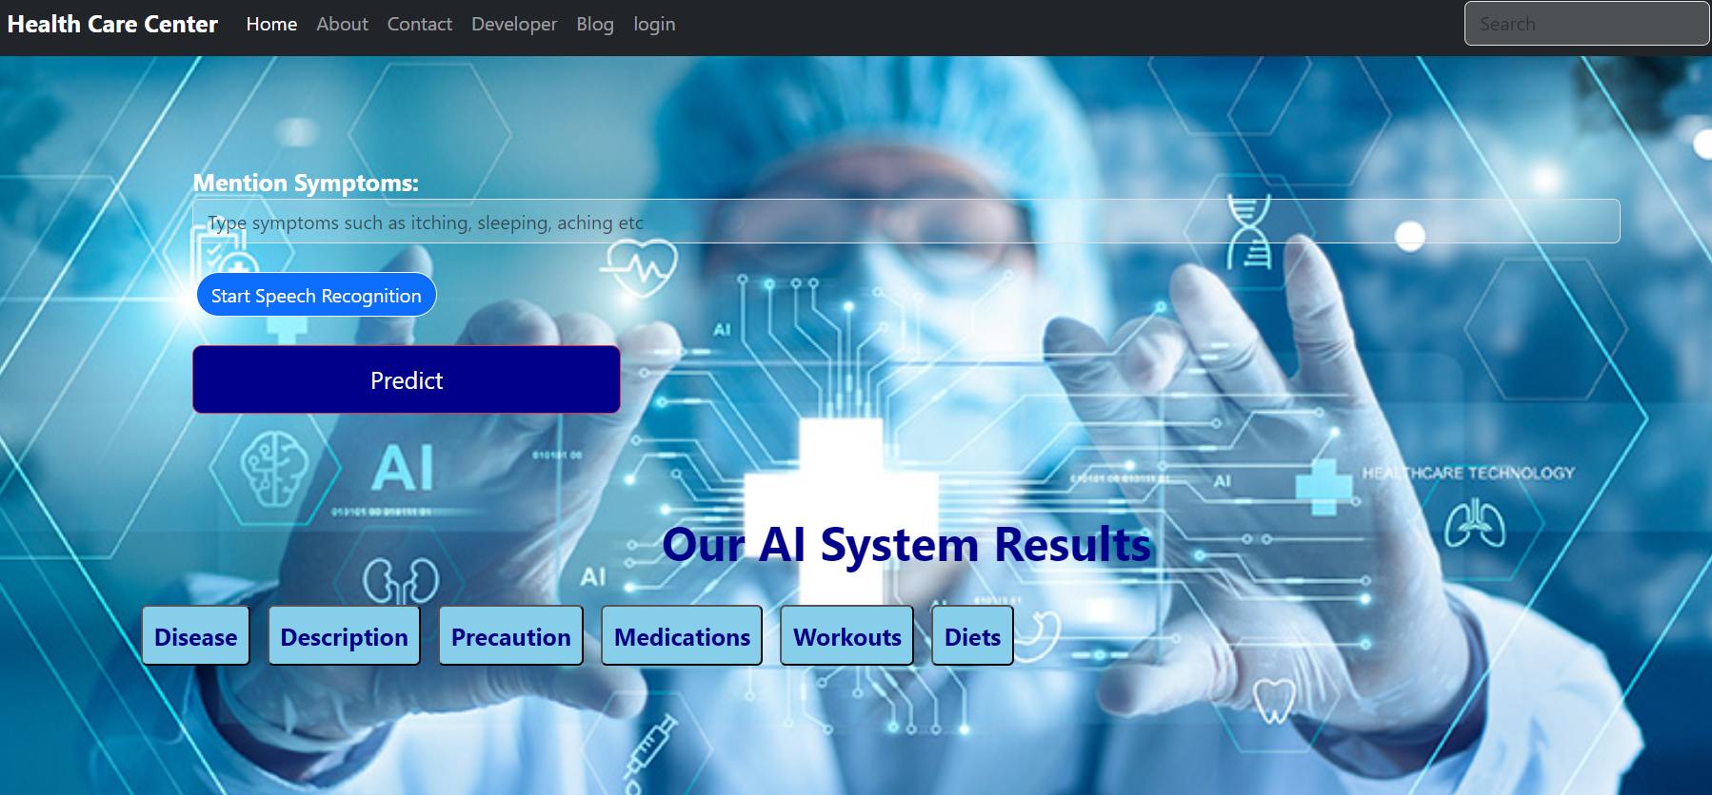
INPUT

Slide 12
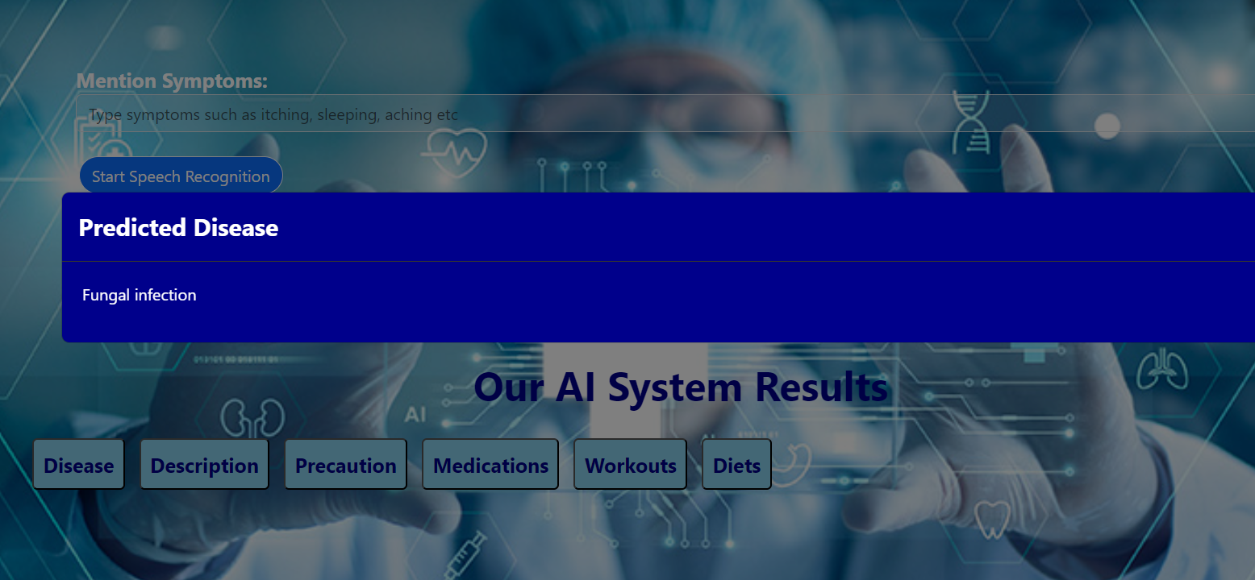
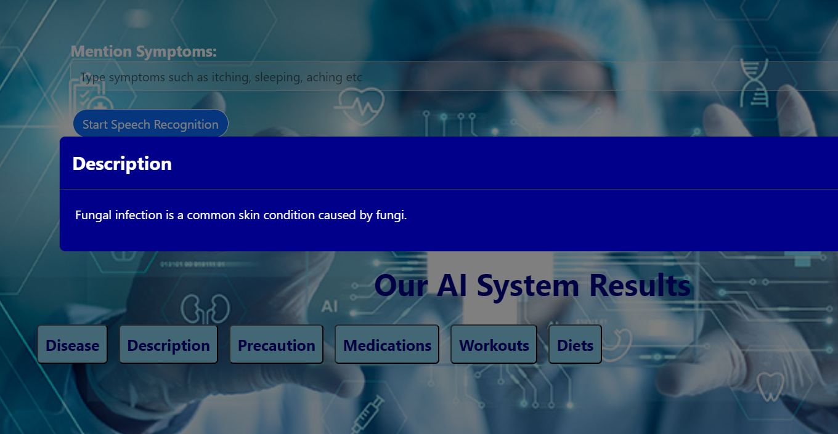
OUTPUT

Slide 13
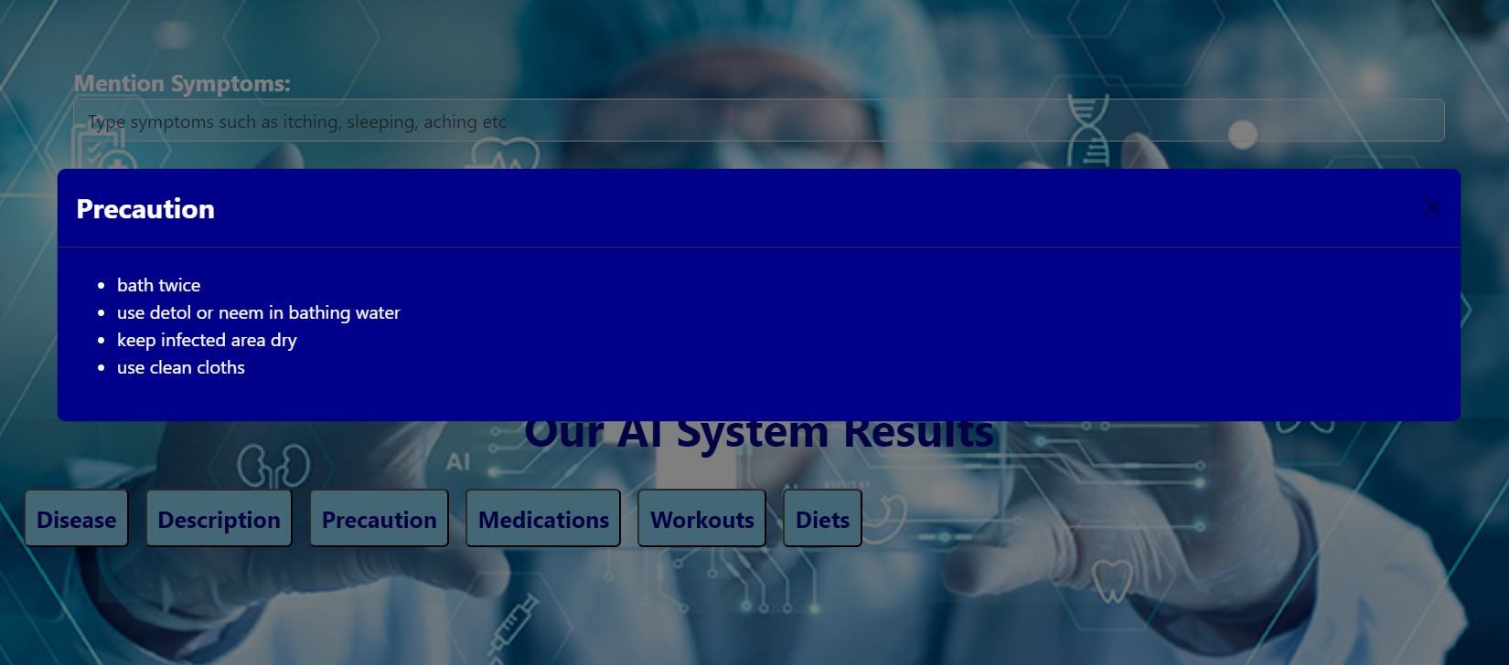
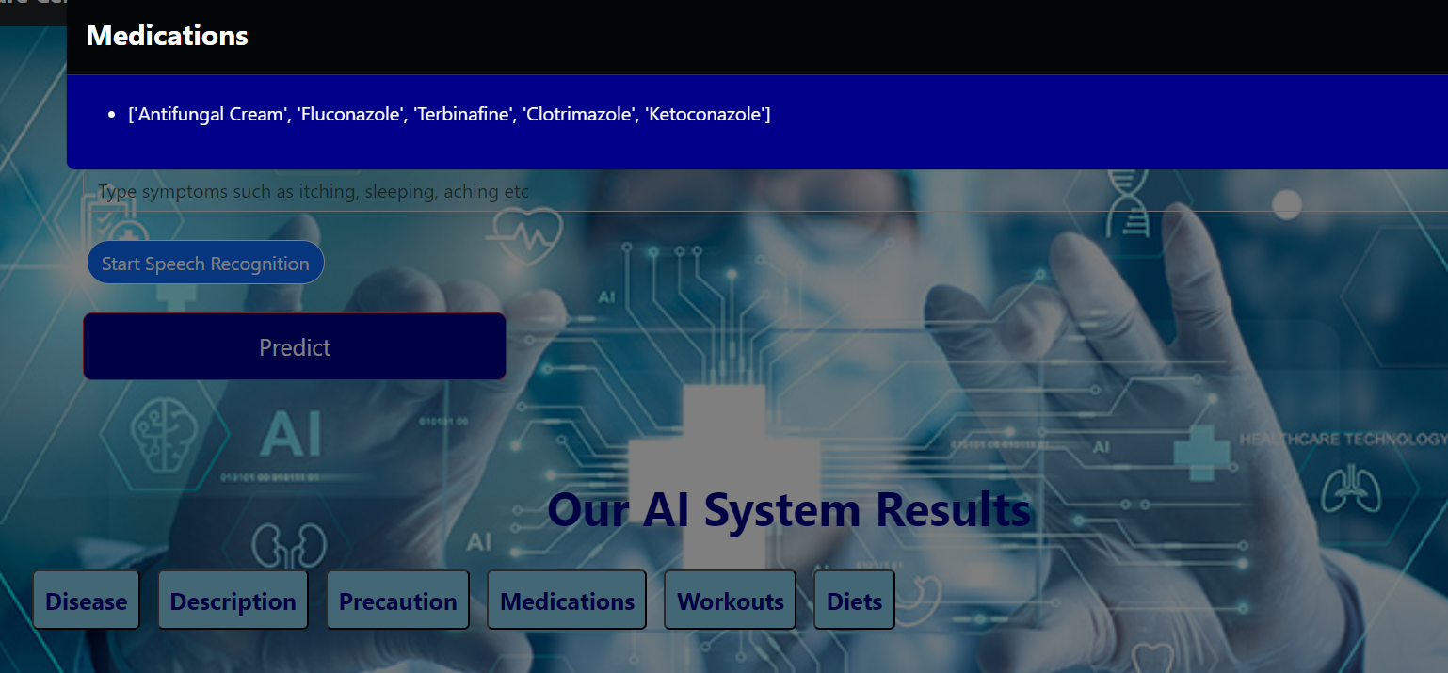

Slide 14
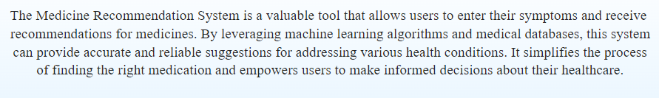


Slide 15
CONCLUSION AND FRAMEWORK
Improved Speech Recognition
Expansion of Dataset and Model
Connectivity with Health Monitoring Apps and Wearable Technology
User Feedback Integration
Implementation in Clinical Environments and Public Health Campaigns:

Slide 16
THANK YOU

